Slide 1
Taunton & District Youth League Season 2024/2025
www.tdyl.co.uk

Slide 3
Registration of players
All Players must be added to your club portal and registered with your club. See info here - https://www.tdyl.co.uk/sfa-affiliation-player-registration/
Check for each player that ID Verification is completed, Consent is given for the player to play (Club Membership renewed), The player is assigned to the correct team and that the Players Information is correct. If all boxes are green, then the player can be submitted to the league for approval.
If all is correct, the league officers will approve the player registration. The player will appear as “registered” in the club portal. Youth Players (U11 to U16) will then show in Full-time and can be selected on your team sheet.
Only players listed as registered are eligible to play in matches.
No youth players will appear on the public FA Fulltime website.
A player can only sign for one club in their age group, in the same competition. They can play for the team above their age group, within their club but must also be registered to play for that team in that age group.
If a player wishes to play for another team they must be transferred following the league transfer process.

Slide 4
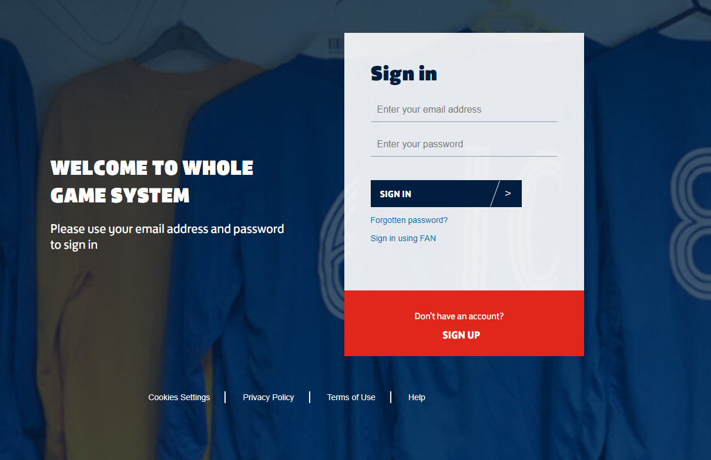
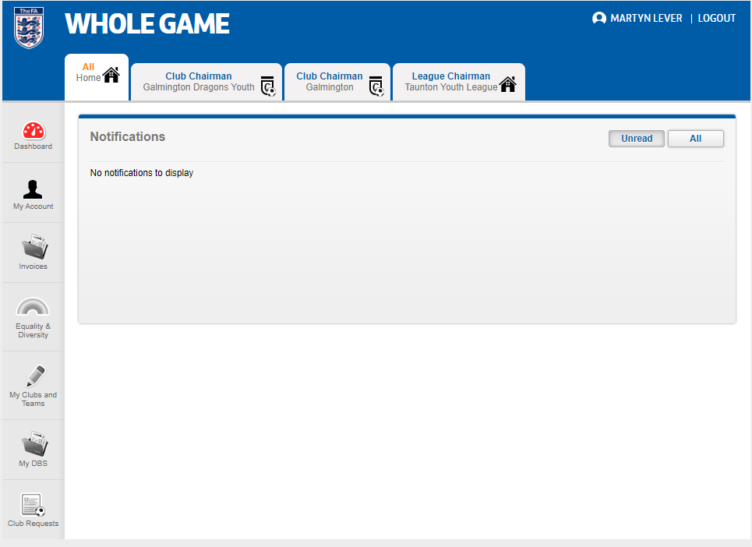
Whole Game Login Screen
Whole Game Dashboard / Club Portal
Click on your role to get access

Slide 5
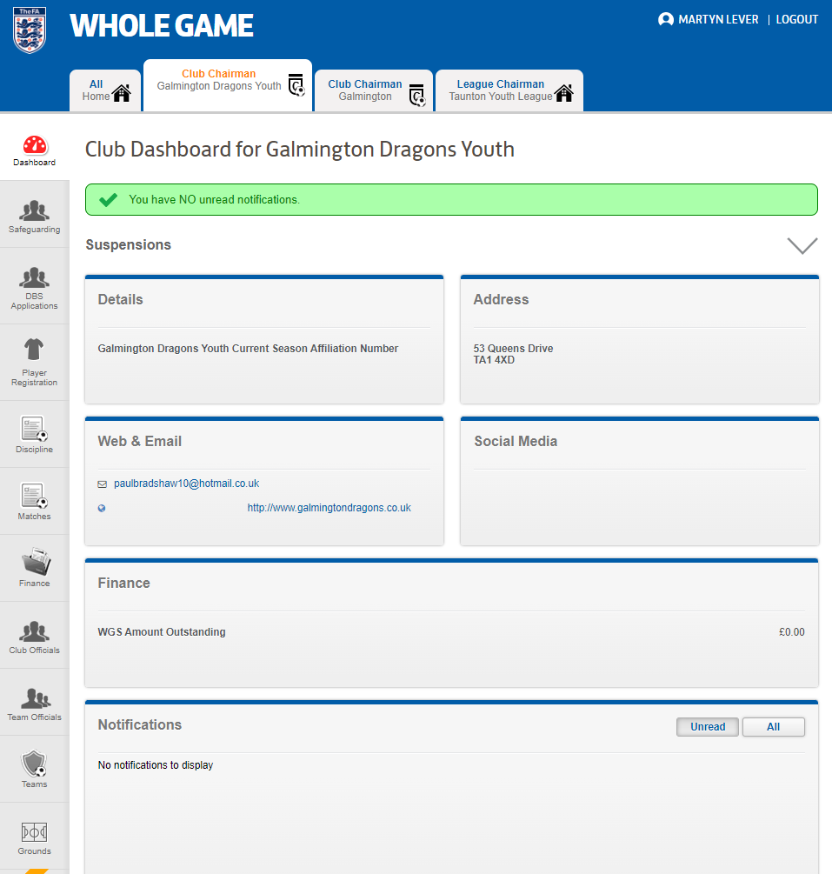
Whole Game / Club Portal
Your club may be setup for your Club Secretary to complete player registrations or you may have a role setup to do this yourself and manage your player registrations
Please note that all players MUST be registered to your club using you clubs registration process. The league will carry out spot checks during the season to tally club membership with league information.
All Player Registrations are via your Club Portal. You do not need to submit a separate Manager/Player information form as per previous seasons.

Slide 6
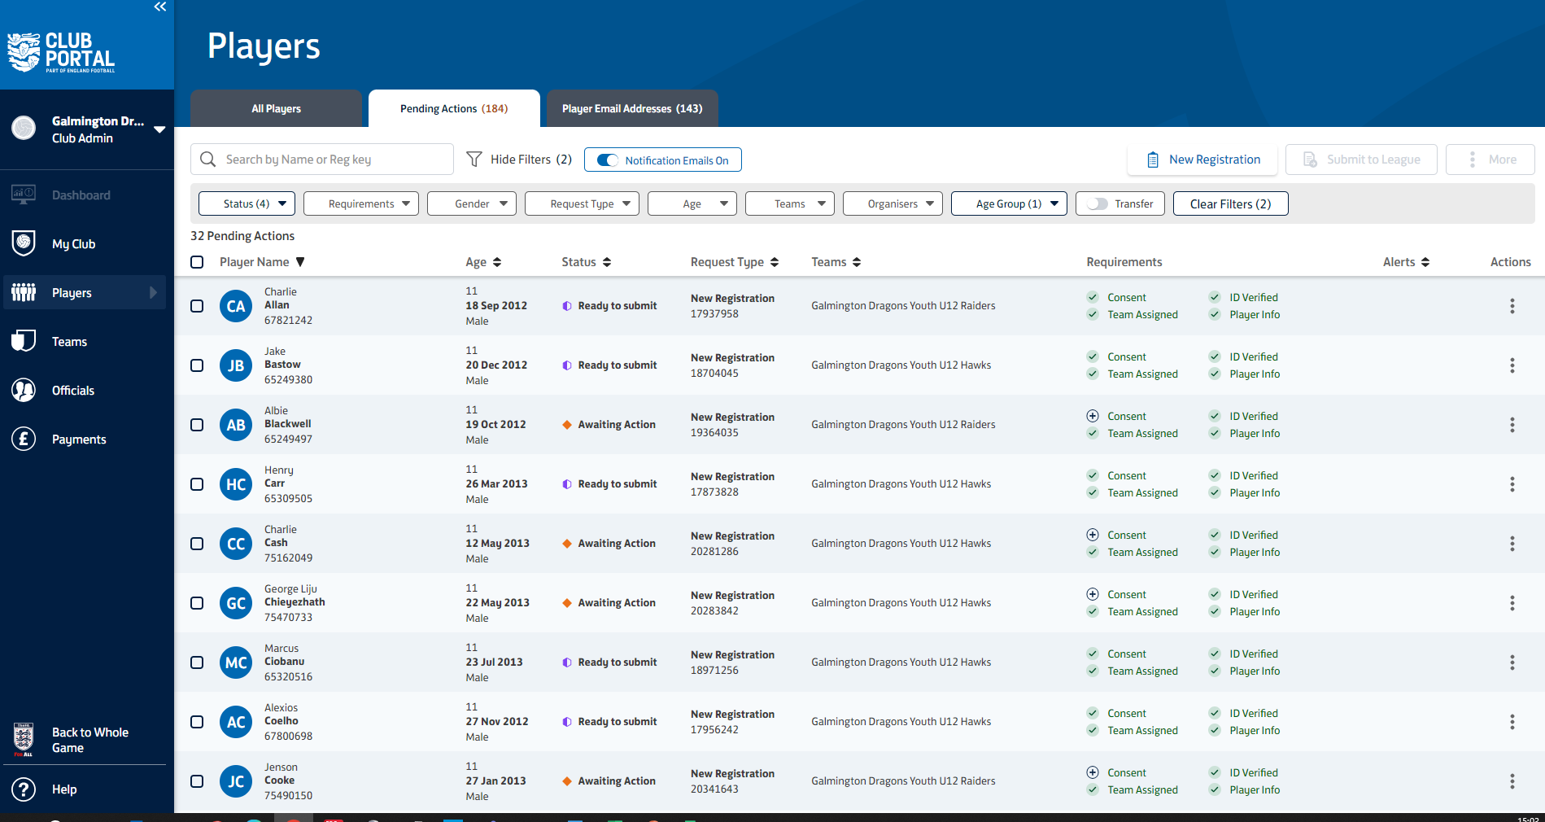
Ready to submit to the league
Can’t be submitted to the league

Slide 7
Make sure your age group manager and coach details are correct (if you don’t have access then check with your club secretary)
Please note that the league cannot change these details

Slide 8
Transfers
Players are only allowed to play for one team within the same competition and must be registered to that team.
The Transfer process:
The new club Secretary must email the existing club Secretary and request the transfer of the player. The League Age Group Secretary must be copied into this email
The existing club Secretary must acknowledge this email within 3 days, with a yes to agree to the transfer or a no.
If yes, the new club can find the player on the FA system and add them to their Club Portal
An invoice will be raised to the new club for the £10 transfer fee and paid before the transfer can be completed.
Transfer will be approved by the league officer and the player can start to play for their new team
Free transfer of a player between 2 teams in the same club in the same age group between the 20th and the 28th Oct and the 20th and 28th Feb.
The player should not play for the new team until approval has been granted.
Only one player may transfer per month, per team.
No Transfers after 1st March.

Slide 9
League Rules
Fixtures are to be played on the date, and time scheduled on Full time where possible and should be changed unless there is a clash. Start times can be changed by the manager once agreed with the age group secretary. The age group Secretary can be contacted using the contact link on the league website. Once agreed the change can be made by the manager in Full-time.
Games MUST NOT be postponed until a conversation has taken place with the age group secretary - use WhatsApp to message. If postponement is agreed, then the age group secretary will update full-time.
You must complete the match day postponement form on the league website once agreed, and the referee and opposition must be contacted by the home team.
Managers must contact the appropriate age group secretary for your age group should a problem arise. Please use the contact form on the league website to do this.
Managers may request three closed dates per season giving the age group secretary a month's notice. Fixtures will be scheduled during holidays where needed (except for Christmas). If you need to close a date, make sure you plan ahead. Trying to close a date a week before will not be approved. Things to think about – no manager or coach cover, players on a school trip or not available etc. No closed date for school trips.
If you cannot raise a side with the minimum required players to play (6 players for 9v9) you must forward proof that you do not have enough players for the game in question via the correct contact form on the website.

Slide 10
League Rules
Players must not wear spectacles. Contact lenses or sport goggles must be worn instead. This is a health and safety requirement.
On a match day you can play with minimum of 6 players (9v9) & a minimum of 9 players (11v11). If you have enough you will play the game.
A maximum of 21 players can register per team – twice the age group format + 3

Slide 11
League Rules
Powerplay Rule for U11s
The powerplay rule will take effect within an U11 game if a team is losing by a 5-goal difference a further additional player can be added so that 9 v 9 becomes 10 v 9.
However, if the goal difference reduces to less that 5 then a player needs to be removed, returning to 9 v 9. This does not need to be the player that was added.
Should the losing goal difference increase from 5 to 10 then a further additional player can be added so that 10 v 9 becomes 11 v 9.

Slide 12
ASK
If in any doubt, ask your age group Secretary for help
Use the contact form on the league website to make contact where possible. WhatsApp can be used when appropriate.
Postponements - call your age group Secretary FIRST and use the match day postponement form
Change of time / venue
you can login to FA Fulltime and amend this once agreed with your age group secretary.
Please do this a minimum of 7 days ahead of the arranged fixture or request that
your age group Secretary

Slide 13
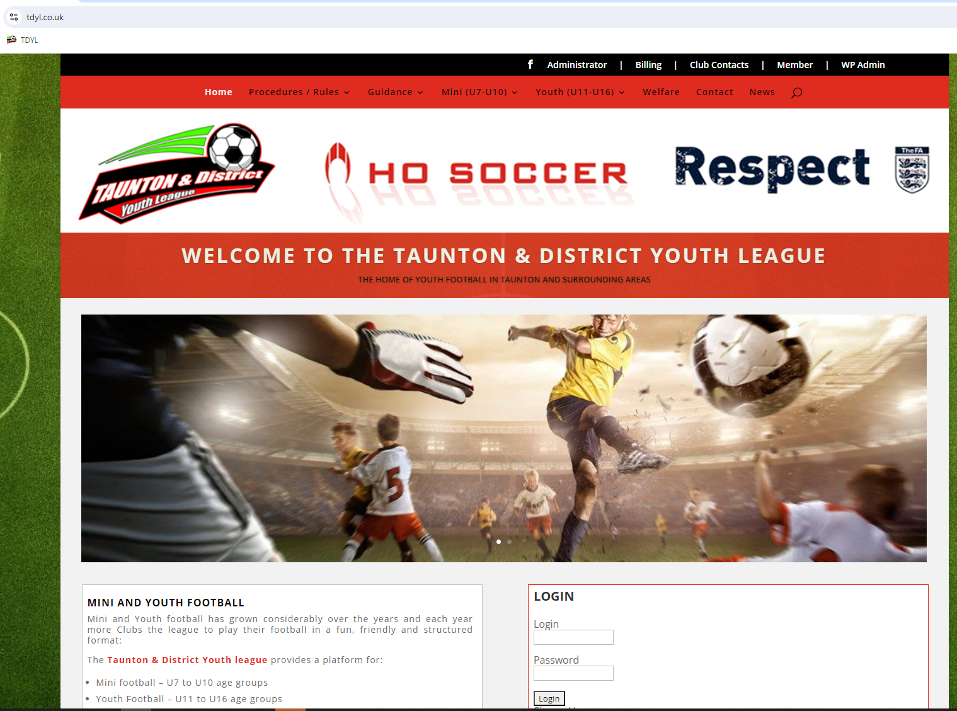
Rules
Fixtures

Slide 14
Pre-Match Preparations
U11 (9 v 9) - 9 Players on the pitch and a maximum of 5 subs (roll on/off subs with permission of the referee. Must be named correctly on your team sheet along with Manager and coaches.
All players must be registered with the league to be eligible to play. DO NOT play an unregistered player or you will be fined. U12s and up will lose points and be fined.
Home teams are responsible for contacting the Referee and opposition, 3 days prior to a game. Email, phone call or message are OK, but you must give the following details:
the ground (full address & postcode),
playing colours of outfield players and keeper - Home team change colours or wear bibs when there is a clash
facilities (toilets, changing rooms, refreshments), car parking, dogs etc.
If a league referee has not been allocated by Wednesday, teams will need to find a club referee they agree on or referee half the game each.

Slide 15
Match between: | Home Team name vs Away Team name
Date & KO Time: | Day, date, KO time
Venue Details: | Anytown FC, Football Road, FA12 3FA Please note and inform all that the carpark is pay and display. Parking available in the neighbouring streets.
Team Colours: | Blue & White shirts, Blue shorts & socks GK in grey shirt, short and socks
Facilities: | Toilets available in the clubhouse / sports centre / in the local garage across the road.
Hospitality: | Refreshments will be on sale from the kitchen via the outside window
Referee: | Changing room will be available for you or No changing facilities Please confirm your expenses and agree method of payment. Cash at the start of match day or other method of payment i.e. bank transfer.
Confirmation of Fixture Example

Slide 16
Match Day
Please stay in a small technical area on the side-line and not run up and down the touchline. Spectators on one side of the pitch behind respect barrier and coaches and players on the other side of the pitch.
Do not enter the field of play without the referee's permission. All coaches and players to stay behind the respect line keeping the pitch line clear.
Pitches - Corner flags (4 corners + halfway line), correct size goals for 9v9, correct size pitch for 9v9, respect barriers etc. Refer to information on the league website for goal and pitch sizes.
Match Day Guidance - https://www.tdyl.co.uk/match-day/
Coach Guidance - https://www.tdyl.co.uk/coaches/
Match Day Postponement Form - https://www.tdyl.co.uk/match-postponement/

Slide 17
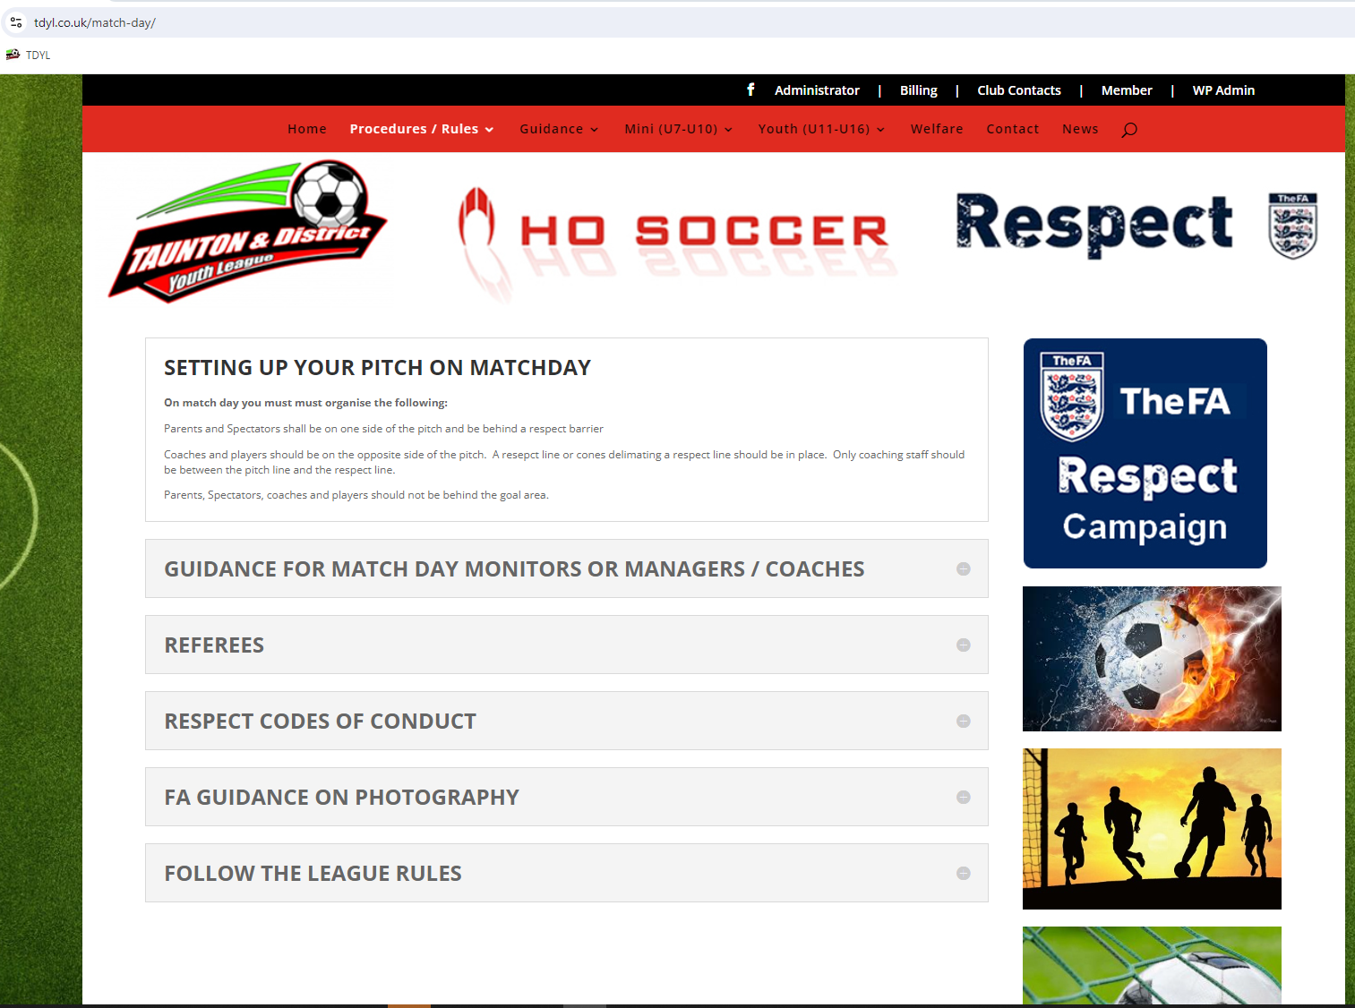

Slide 18
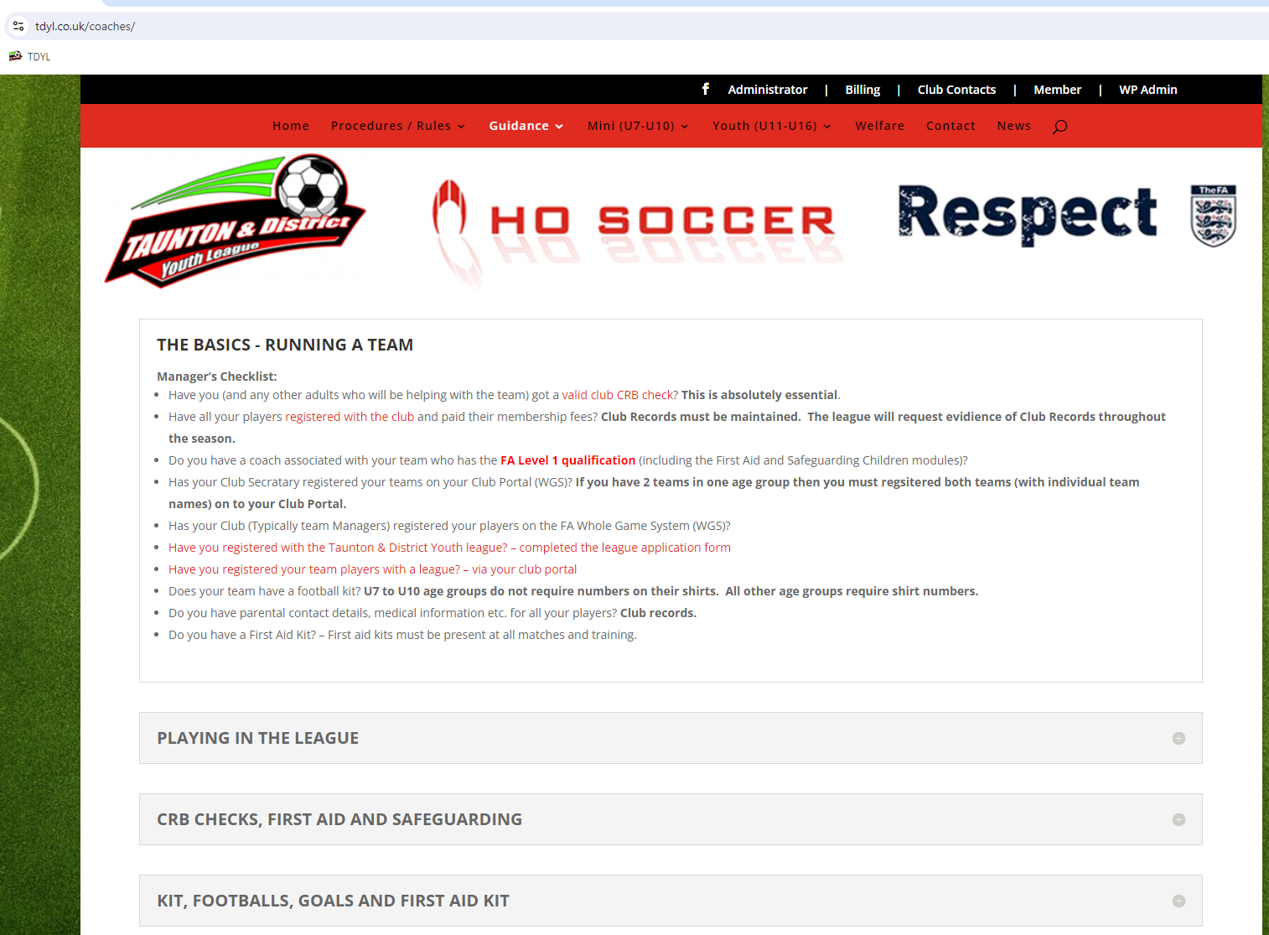

Slide 19
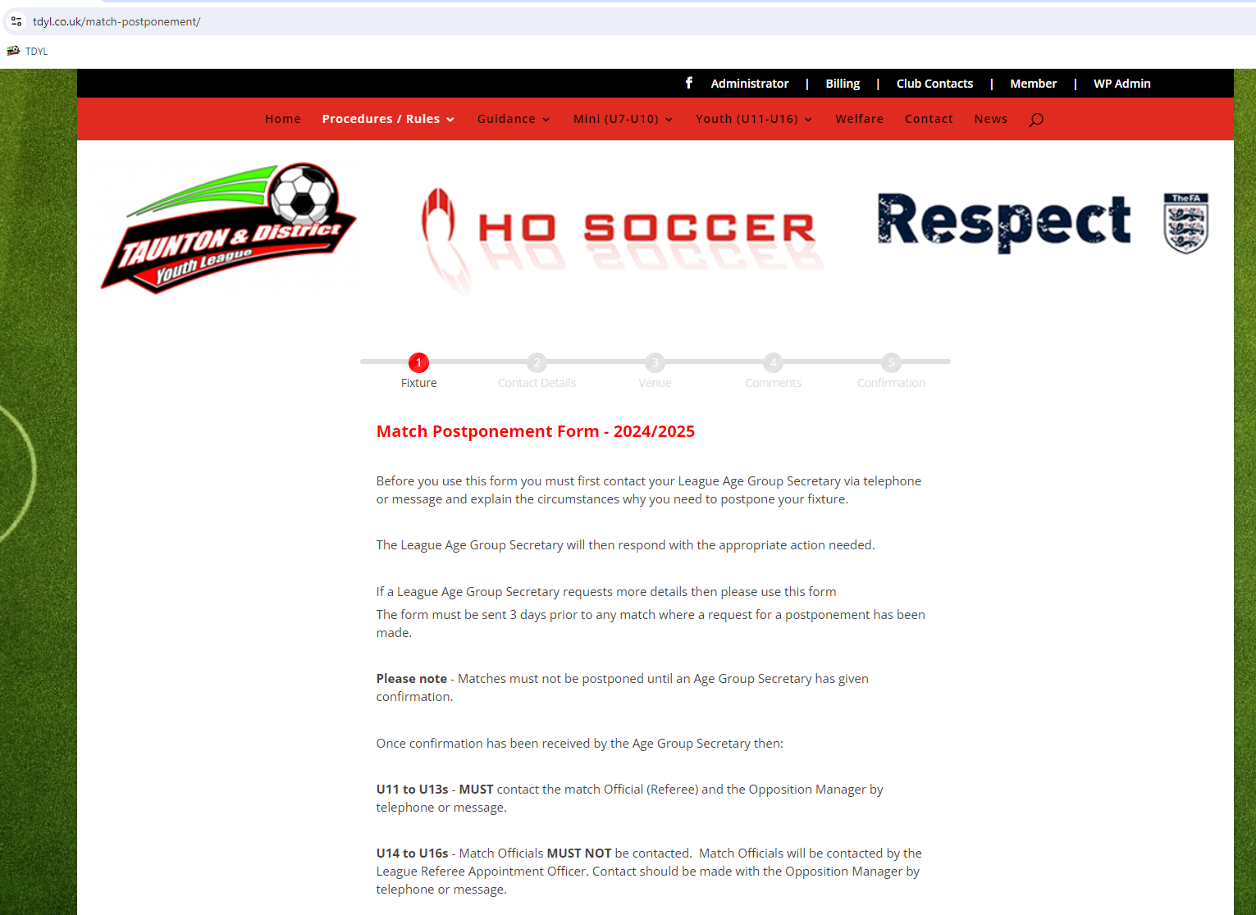

Slide 20
Match Day
Meet & greet, the Referee and away team
Give the referee their money, if cash, or confirm the payment has been made by bank transfer
Fully complete the team sheet and hand a copy to the referee and the opposition team
Monitor your team's behavior, players, parents and coaches – as per FA Traffic Light System
The manager/named head coach is responsible for the players, technical area, supporters and assistant referee if there is one.
Should the referee not be able to identify a culprit the manager/named head coach will receive the yellow card / red card.
Any behavior issues for either team should be reported to your club secretary giving as much information as possible. It is the club secretaries’ responsibility to contact the league via the league contact form on the website.
Every team must have a first Aid kit pitch side. The League do carry out spot checks throughout the season. This is part of the leagues England Accreditation.
Scores need to be submitted via full-time messaging system by 6pm on the day that the game is played, any agreed evening matches by 21:30, However, evening games will not generally occur until U14 (Sunday PM kick offs)

Slide 21
Errors when entering anything other than score
H-A club code
3-0 GD01
Not Correct

Slide 22
Post Match
By Wednesday evening after a match is played, a team sheet MUST be completed on FA Full time and include the following:
The players used
Any discipline issued
A mark for the referee
Fair play scores
You can also add additional stats if you wish:
Goals
Player of match
Captain
Assists
If scores and a match day report are NOT submitted in time, then you will receive a fine.

Slide 23
Cup Matches
All teams will be entered into the Knockout Cup
If your team goes out in your first round of the cup, then you will be added to the Plate Knockout Cup Competition.
Cup matches take priority over a league fixture.
There will be free dates in your calendar these have been set aside for your cup games. You must play your cup fixture.

Slide 24
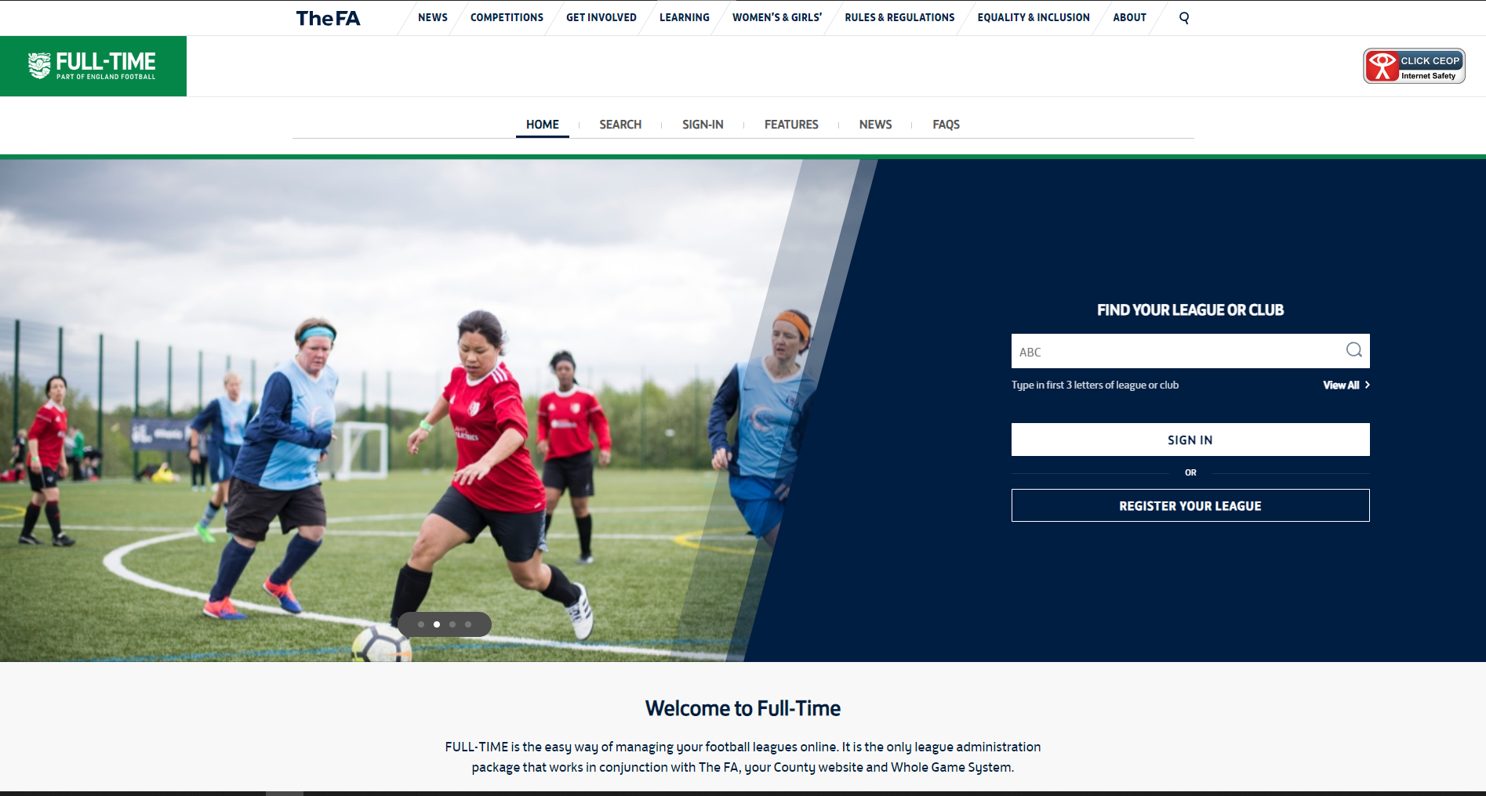
https://fulltime.thefa.com/home/index.html
https://fulltime.thefa.com/home/index.html

Slide 25
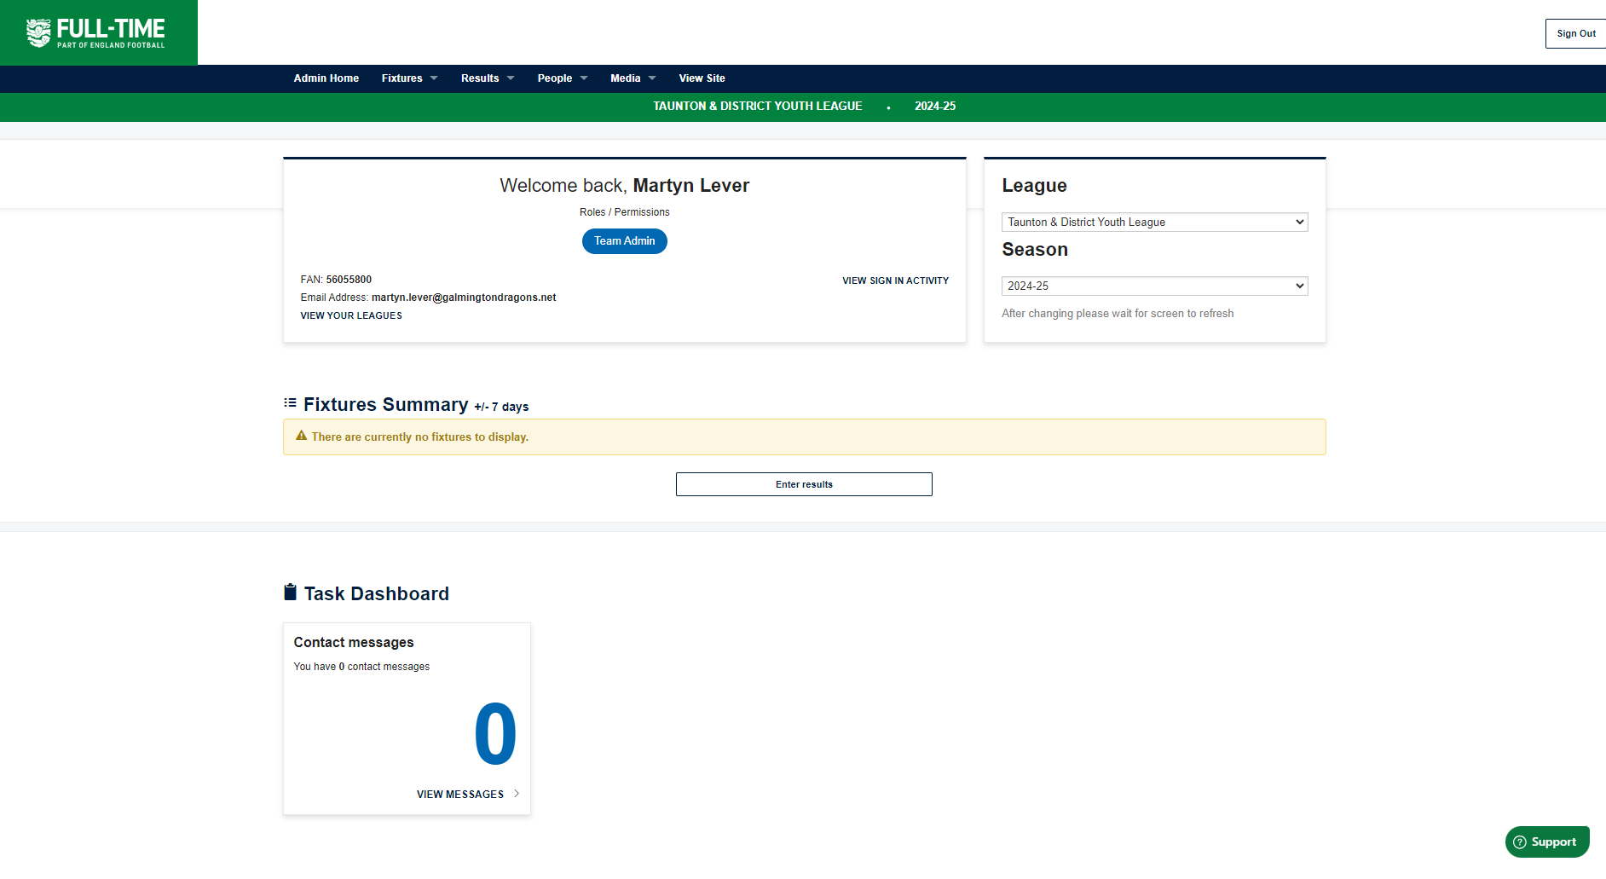
https://fulltime.thefa.com/home/index.html

Slide 26
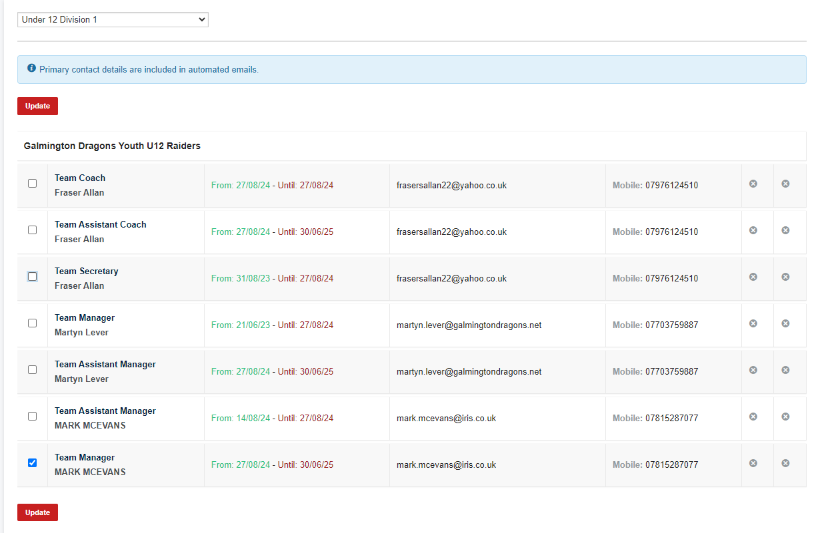

Slide 27
Update match day stats by the Wednesday following match day
Update fixture start time (once approval given from Age Group Secdretary)

Slide 28
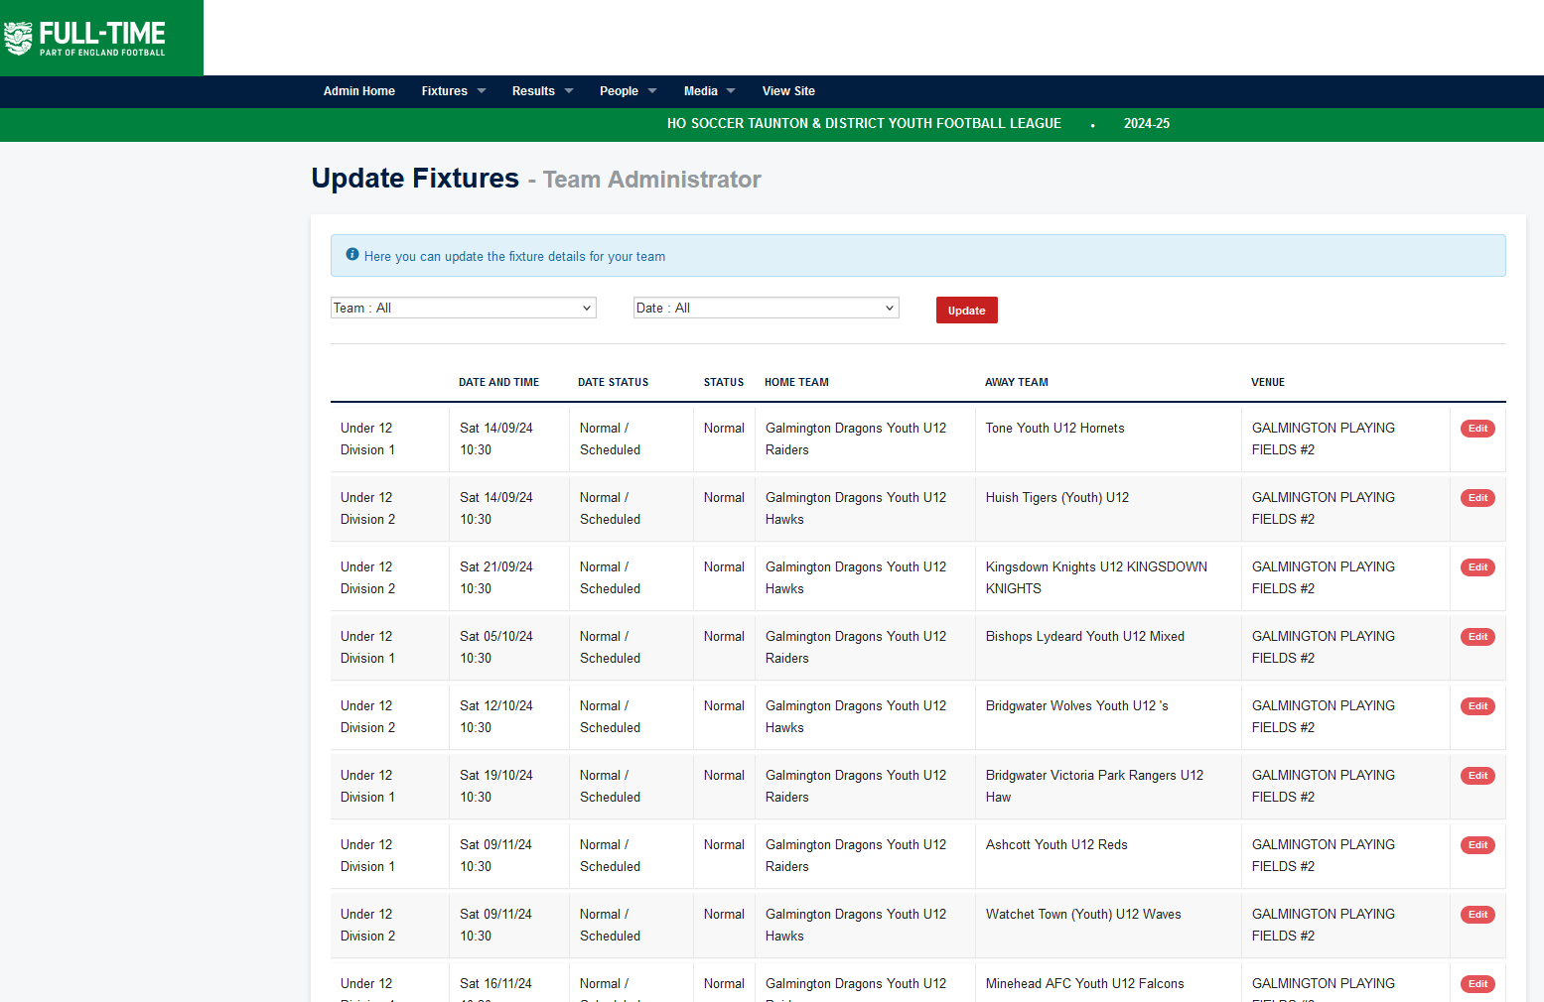

Slide 29
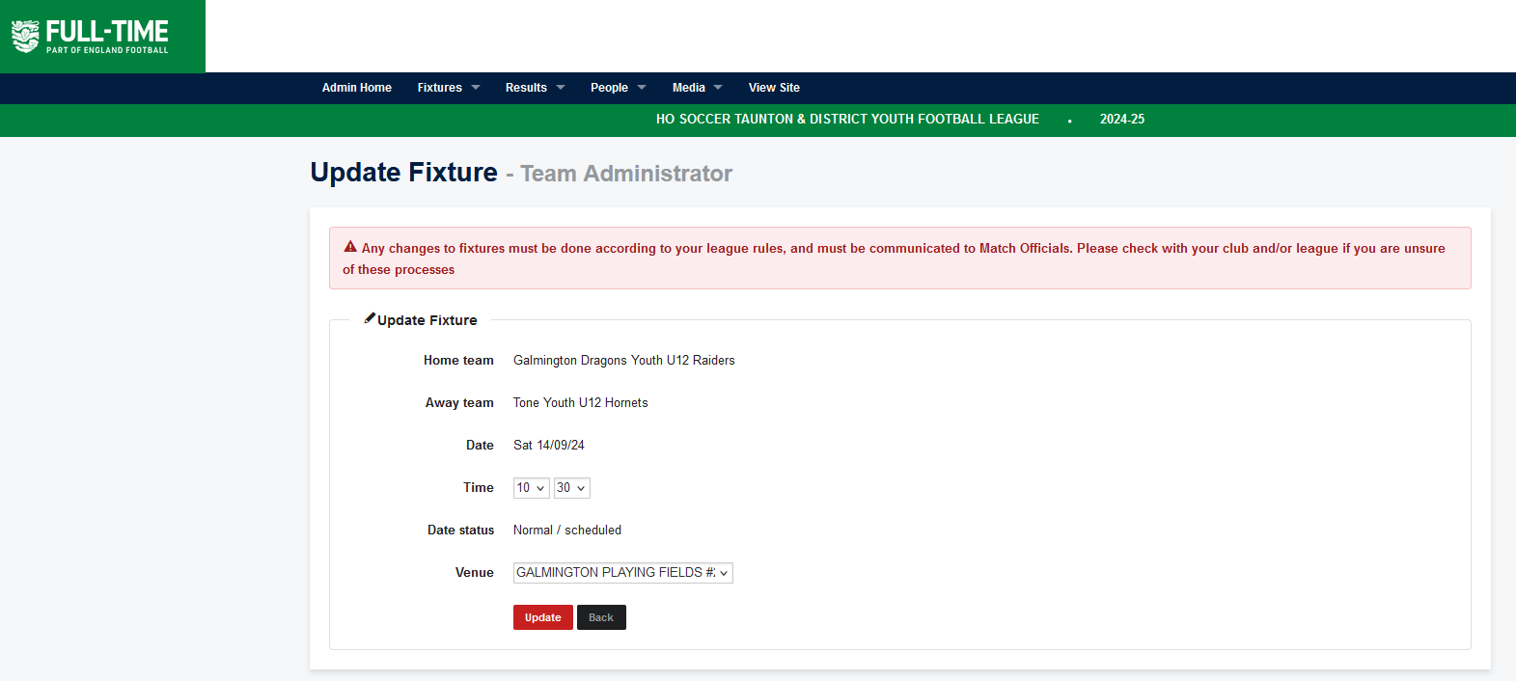
Must be agreed by your Age Group Secretary first
Change kick off time
Change Venue

Slide 30
Fines
Fines will be emailed directly to the club secretary via the leagues online billing system. The club secretary will be given a time frame to be able to respond to the league – see League/SCORY rules. The club secretary can accept or reject the fine.
Should the Club feel the fine is incorrect then the club secretary must respond to the charge using the charge notification form on the website - https://www.tdyl.co.uk/charge-response/ . The club will need to pay a fee of £25 to the league for the committee to review the charge.
Should the decision be successfully overturned your club will be refunded
The items you can get caught out on:
Not contacting the Referee or opposition pre match
Postponing a match incorrectly
Playing an unregistered player
Not completing the team sheet and not giving the Referee and opposition a copy
Not sending in your match day results
Not completing the match day stats on FA Fulltime (be aware if using Matchday App it doesn’t always work)

Slide 31
RESPECT
After each game, the referees are asked to complete a match day report/review
The referees will review both team’s - Players, technical area, supporters and assistant referee
Details are collated by the league. If teams receive poor marks and continue to receive poor marks, then the league will monitor the club and team – refer to the FA Traffic Light System that is being introduced
The Traffic Light System will be used in conjunction with Somerset FA to monitor behavior
Every Referee will have different expectations.
Show respect when you greet the referee and when the referee checks the players boots & equipment and has a chat with the players.
Accept the decisions and encourage players and parents to accept all decisions made by the referees. They are only human and can make mistakes.
At the end of the game, shake the referee's hand and thank them for coming. Without their involvement your game will not go ahead.

Slide 32
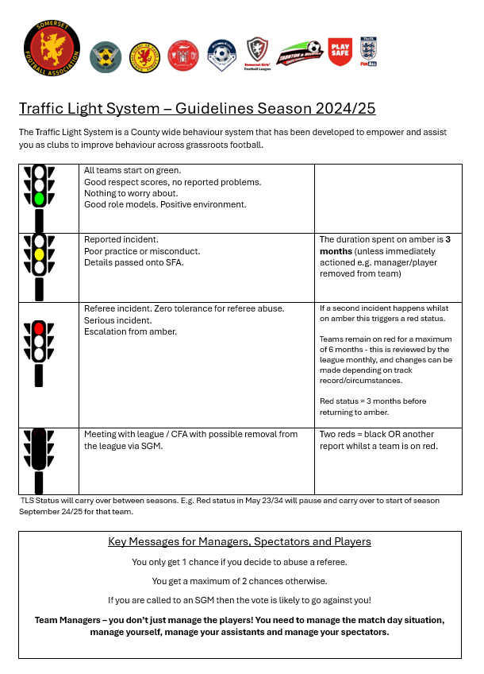

Slide 33
Questions?
www.tdyl.co.uk

